Slide 1
PrepAssist
simple assistant for meal prepping

Slide 2
WHAT?
A tool to parse a website for its recipe,
and then help catalog and prepare that recipe

Slide 3
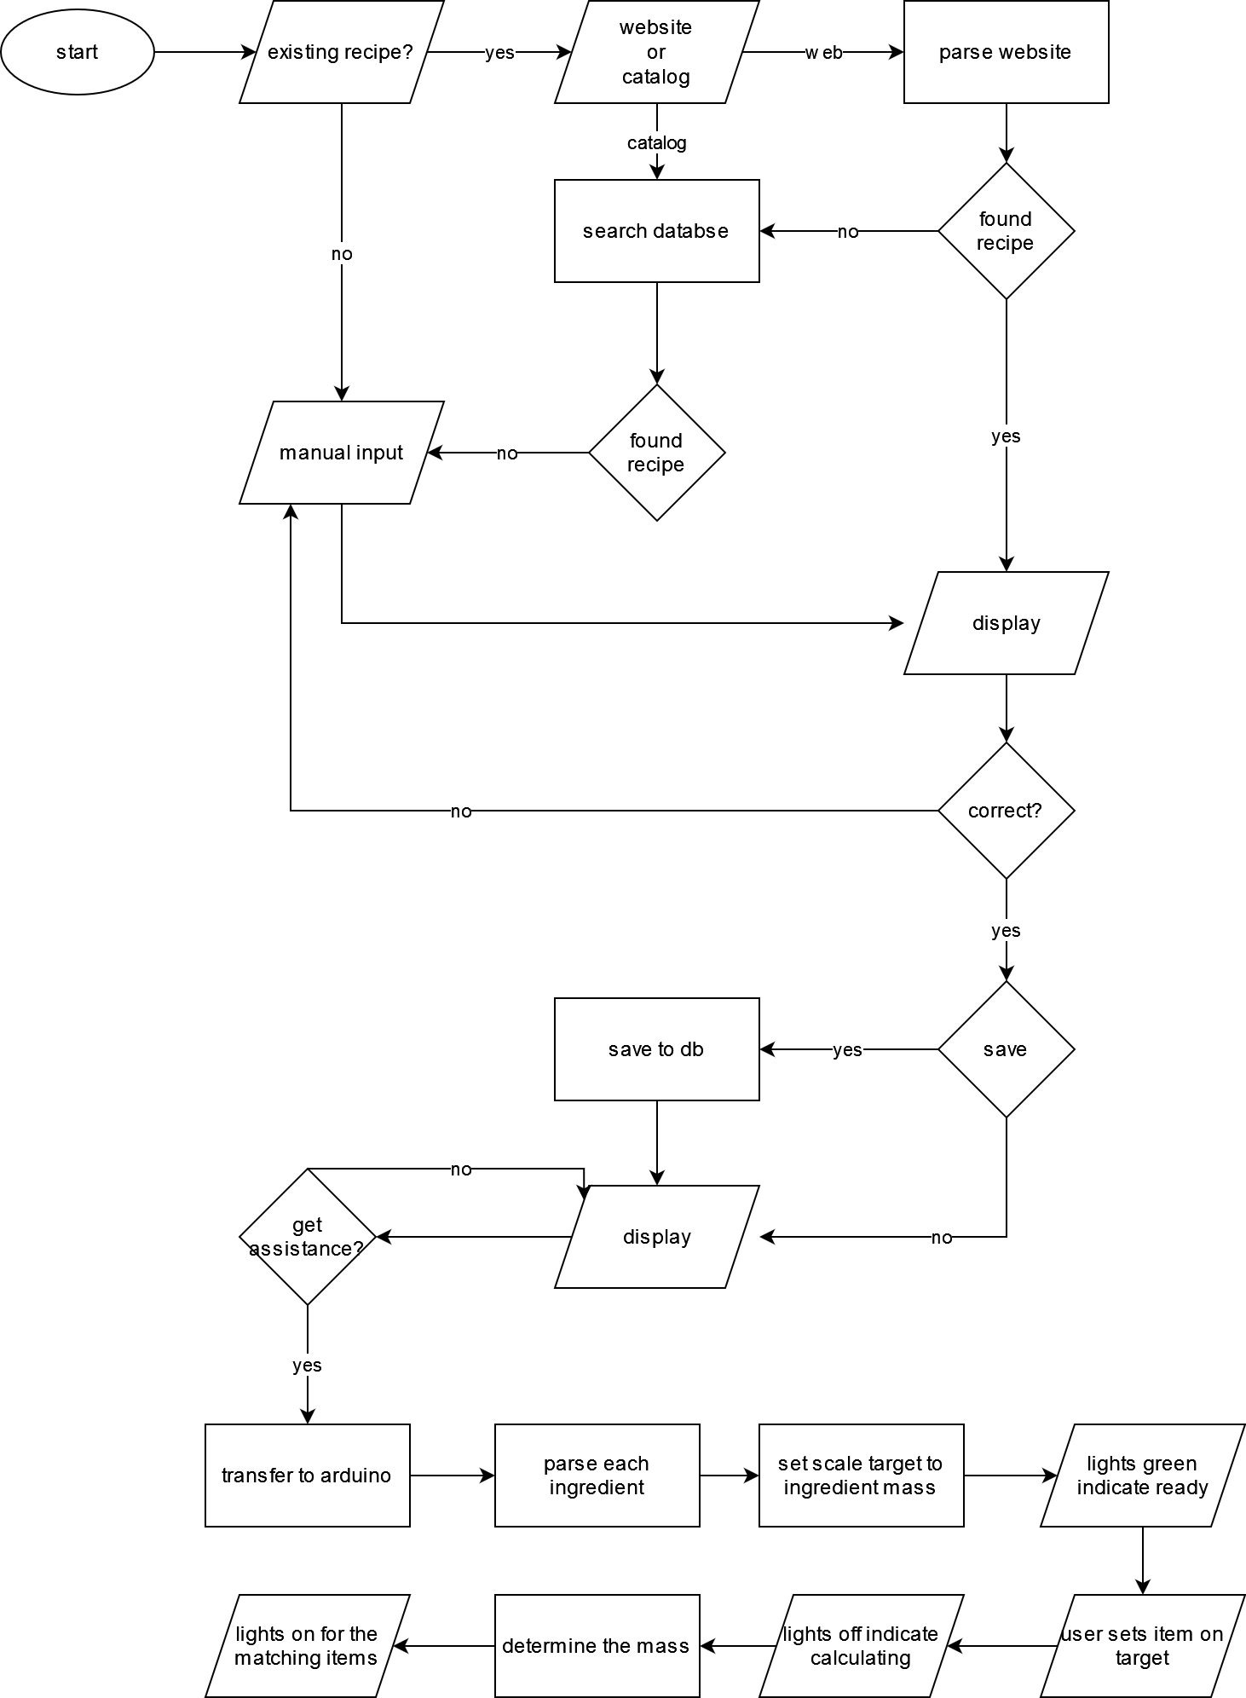
SOFTWARE FLOW
Website parsing
Scrape through a website and get the recipe data
If not exist then input manually

Slide 4
SOFTWARE FLOW
Data saving
Catalog recipe into database if user permits
Hardware component
Send ingredients into an Arduino controller and get a combination of ingredient that match the desired amount

Slide 5
OPTIONAL
Catalog system using QR scanning
Using catalog ID to convert into QR data
Use a phone camera to read the code
Send to database
User account system for saving personalized data
Save login info
Use encryption or hashing so the password is unreadable

Slide 6
LANGUAGES and TOOLS
Backend
Java for the main driver program
Python for web parsing
MySQL for the language back end
C++ for Arduino control
Tools
Google Cloud for database hosting or local server
GitHub for version control
Arduino for hardware component

Slide 7
GOALS and SKILLS (for your resume)
Within the confines of New York Tech
Demonstrate proficiency in Java as taught in Programming I and II
Demonstrate ability to create the algorithm for calculating the optimal item combination
Demonstrate proficiency in database management
Demonstrate web parsing as taught in Information Retrieval
Additional skills
Version control with GitHub as many projects use
Ability to learn new things and integrate new tech with Arduino hardware
Ability to create a robust and redundant and usable system

Slide 8
THANK YOU

